Slide 2
ADO.NET

Slide 3
ADO.NET
Microsoft® ADO.NET is the technology that you use to connect Microsoft .NET-based Web applications and Microsoft Windows® applications to data sources, such as Microsoft SQL Server™ databases and Extensible Markup Language (XML) files
Designed for distributed and Web applications
Provides 2 models for data access
Connection-oriented
Connectionless

Slide 4
Data Providers
Microsoft’s layered architecture for data access
ADO.NET
SQL Server
Oracle
MySQL
ODBC
OLEDB
SQL-data
Non-SQL-data
MS SQL Server, Oracle,
Jet, Foxpro, ...
Directory Services, Mail,
Text, Video, ...

Slide 5
.NET Framework Data Providers
NET Framework data provider | Description
.NET Framework Data Provider for SQL Server | Provides data access for Microsoft SQL Server. Uses the System.Data.SqlClient namespace.
.NET Framework Data Provider for OLE DB | For data sources exposed by using OLE DB. Uses the System.Data.OleDb namespace.
.NET Framework Data Provider for ODBC | For data sources exposed by using ODBC. Uses the System.Data.Odbc namespace.
.NET Framework Data Provider for Oracle | For Oracle data sources. The .NET Framework Data Provider for Oracle supports Oracle client software version 8.1.7 and later, and uses the System.Data.OracleClient namespace.
EntityClient Provider | Provides data access for Entity Data Model (EDM) applications. Uses the System.Data.EntityClient namespace.
.NET Framework Data Provider for SQL Server Compact 4.0. | Provides data access for Microsoft SQL Server Compact 4.0. Uses the System.Data.SqlServerCe namespace.

Slide 6
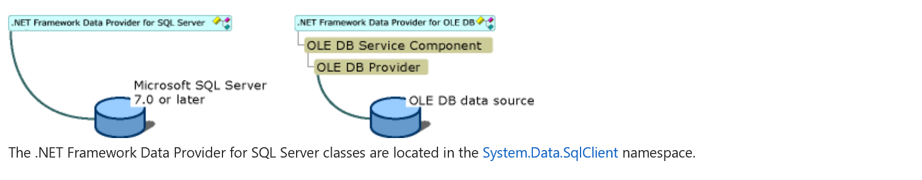
Comparison

Slide 7
ADO.NET Assemblies
Assembly
System.Data.dll
Namespaces:
System.Data general types
System.Data.Common classes for implementing providers
System.Data.OleDb OLE DB provider
System.Data.SqlClient Microsoft SQL Server provider
System.Data.SqlTypes data types for SQL Server
System.Data.Odbc ODBC provider (since .NET 1.1)
System.Data.OracleClient Oracle provider (since .NET 1.1)
System.Data.SqlServerCe Compact Framework

Slide 8
Core Objects of .NET Framework Data Providers
Object | Description
Connection | Establishes a connection to a specific data source. The base class for all Connection objects is the DbConnection class.
Command | Executes a command against a data source. Exposes Parameters and can execute in the scope of a Transaction from a Connection. The base class for all Command objects is the DbCommand class.
DataReader | Reads a forward-only, read-only stream of data from a data source. The base class for all DataReader objects is the DbDataReader class.
DataAdapter | Populates a DataSet and resolves updates with the data source. The base class for all DataAdapter objects is the DbDataAdapter class.

Slide 9
Connection-oriented versus Connectionless
Connectionless
No permanent connection to the data source
Data cached in main memory
Changes in main memory may be in conflict with changes in data source
Intended for applications with:
many parallel and long lasting access operations.
Connection-oriented
Keeps the connection to the data base alive
Always up-to-date data
Intended for applications with:
short running transactions
only a few parallel access operations

Slide 10
Connection Oriented Architecture
DbConnection
represents connection to data source
DbCommand
represents a SQL command
DbTransaction
represents a transaction
commands can be executed within a transaction
DataReader
result of a data base query
allows sequential reading of rows

Slide 11
Class Hierarchy
General interface definitions
IDbConnection
IDbCommand
IDbTransaction
IDataReader
Special implementations
OleDb: implementation for OLEDB
Sql: implementation for SQL Server
Oracle: implementation for Oracle
Odbc: implementation for ODBC
SqlCe: implementation for SQL Server CE data base

Slide 12
Pattern for Connection Oriented Access
Declare a Connection
try
{ Request /Open connection to data base
Execute Sql Statements
process Results
release resource
}
catch
{
Exception
}
Finally
{ Close connection
}

Slide 13
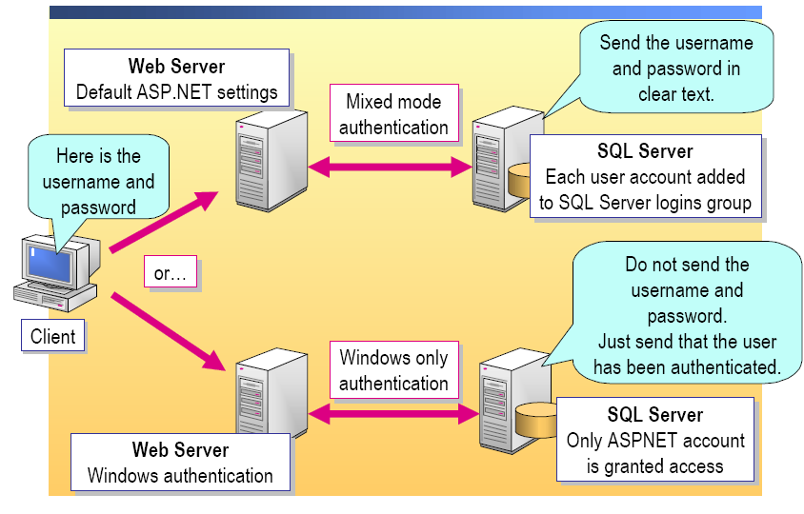
SQL Server Security

Slide 14
Connection Strings
Windows Authentication
string strConn =
"data source=localhost; " +
"initial catalog=northwind; " +
"integrated security=true";
SqlConnection conn = new SqlConnection(strConn);
Mixed Mode Authentication
string strConn =
"data source=localhost; " +
"initial catalog=northwind; " +
"user id=CohoUser; " +
"password=1Coho";
SqlConnection conn = new SqlConnection(strConn);

Slide 15
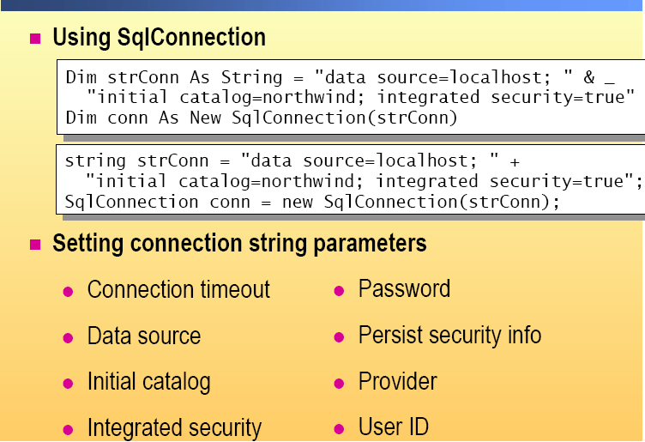
Connection parameters

Slide 16
Command
Command is, in its simplest form, a string of text containing SQL statements that is to be issued to the database
Executed for a connection
command could also be a stored procedure, or the name of a table that will return all columns and all rows from that table (in other words, a SELECT *-style clause)
May have parameters
May belong to a transaction

Slide 17
Executing Commands
Executing Commands
After you have defined the command, you need to execute it. There are a number of ways to issue the statement, depending on what you expect to be returned (if anything) from that command. The <provider>Command classes provide the following execute methods:
ExecuteNonQuery()—Executes the command but does not return any output
Execute Reader()—Executes the command and returns a typed IDataReader
Execute Scalar()—Executes the command and returns a single value
In addition to these methods, the SqlCommand class also exposes the following method
ExecuteXmlReader()—Executes the command and returns an XmlReader object, which can be used to traverse the XML fragment returned from the database.

Slide 18
Command Type
Command Type | Example
Text (default) | String select = “SELECT ContactName From Customers”; SqlCommand cmd = new SqlCommand(select , conn);
Stored Procedure | SqlCommand cmd = new SqlCommand(“CustOrderHist”, conn); cmd.CommandType = CommandType.StoredProcedure; cmd.Parameters.Add(“@CustomerID”, “QUICK”)
Table Direct | OleDbCommand cmd = new OleDbCommand(“Categories”, conn); cmd.CommandType = CommandType.TableDirect;

Slide 19
Data Readers
Forward-only, read only
Fast access to data
Connected to a data source
Manage the connection yourself
Manage the data yourself, or bind it to a list-bound control
Uses fewer server resources

Slide 20
Execute Reader
IDataReader ExecuteReader()
IDataReader ExecuteReader( CommandBehavior behavior );
Executes the data base query specified in CommandText
Result is an IDataReader object
Example
cmd.CommandText =
"SELECT EmployeeID, LastName, FirstName FROM Employees "; IDataReader reader = cmd.ExecuteReader();

Slide 21
Data Reader
IDataReader allows sequential reading of result (row by row)

Slide 22
Creating a Data reader

Slide 23
Reading Data from Data Reader

Slide 24
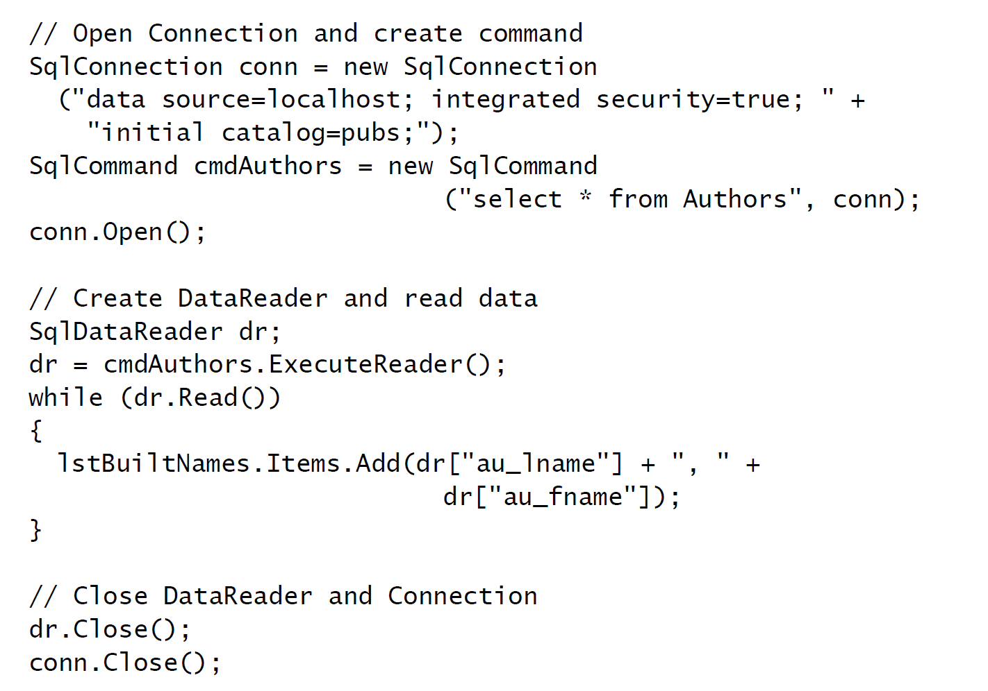
Code

Slide 25
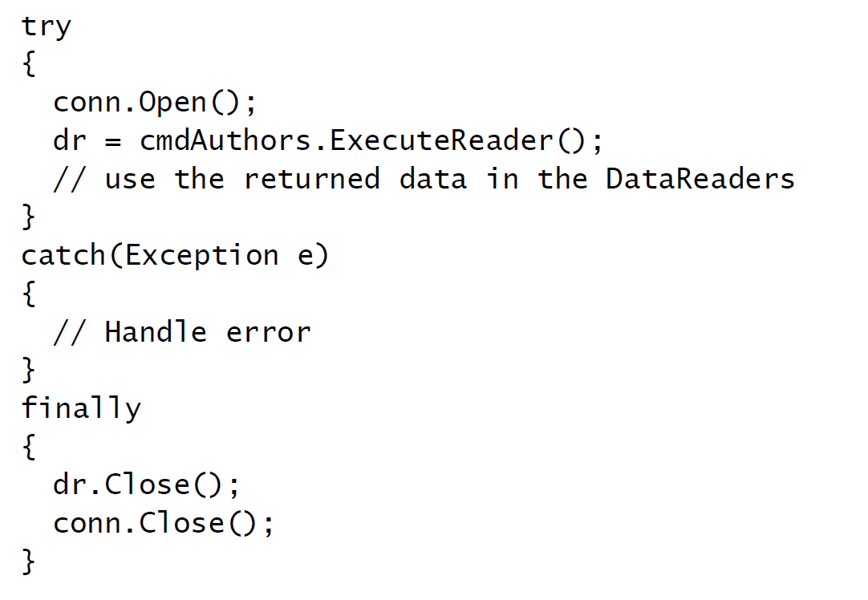
Use Try…Catch…Finally

Slide 26
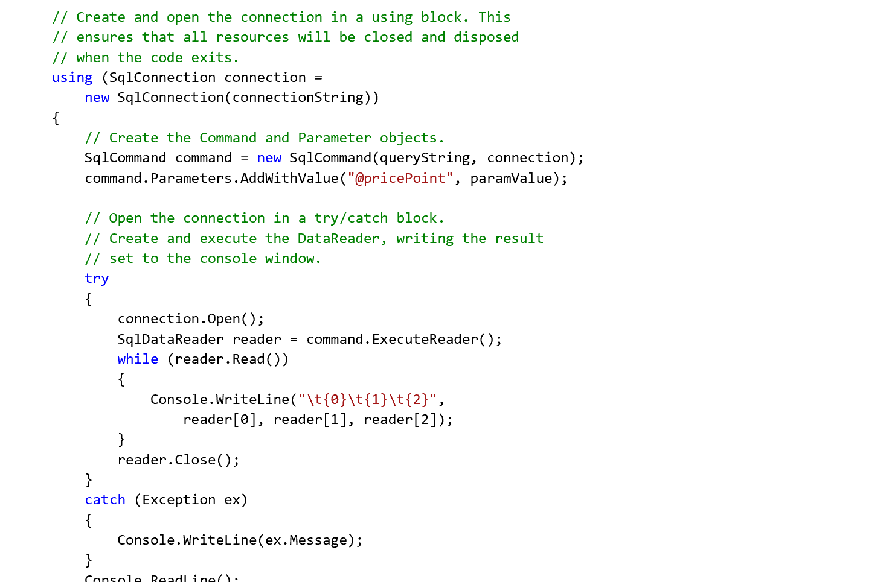
Using “Using”

Slide 27
Execute Non Query Method
Executes the non-query operation specified in CommandText
UPDATE
INSERT
DELETE
CREATE TABLE
…
Result is number of affected rows
Example
cmd.CommandText = "UPDATE Empls SET City = ’Seattle’ WHERE iD=8"; int affectedRows = cmd.ExecuteNonQuery();

Slide 28
Execute Scalar
Returns the value of the 1st column of the 1st row delivered by the query
CommandText typically is an aggregate function
Example
cmd.CommandText = " SELECT count(*) FROM Employees "; int count = (int) cmd.ExecuteScalar();

Slide 29
Execute XML Reader
SqlClient Provider Only
As its name implies, this method executes the command and returns an XmlReader object to the caller. SQL Server permits a SQL SELECT statement to be extended with a FOR XML clause. This clause can take one of three options:
FOR XML AUTO—Builds a tree based on the tables in the FROM clause
FOR XML RAW—Maps result set rows to elements, with columns mapped to attributes
FOR XML EXPLICIT—Requires that you specify the shape of the XML tree to be returned

Slide 30
Stored Procedures
A stored procedure is a database procedure that a database developer writes for use with a specific database
applications can then call these stored procedures to access and manipulate data in the database.
Stored procedures allow you to access a database by calling an existing procedure rather than having to write your own SQL statements.
Types:
Return records stored procedures
Return value stored procedures,
Action stored procedures

Slide 31
Benefits OF SP
Modular programming
You create the procedure once, test it once, store it on the database server, and then call it any number of times from multiple applications.
Distribution of work
Increase database security
Using stored procedures provides increased security for a database by limiting
direct access. Stored procedures generally result in improved performance because the database can optimize the data access plan used by the procedure and cache it for subsequent reuse
Faster execution
Stored procedures generally result in improved performance because the database can optimize the data access plan used by the procedure and cache it for subsequent reuse
Reduce network traffic
Provides flexibility

Slide 32
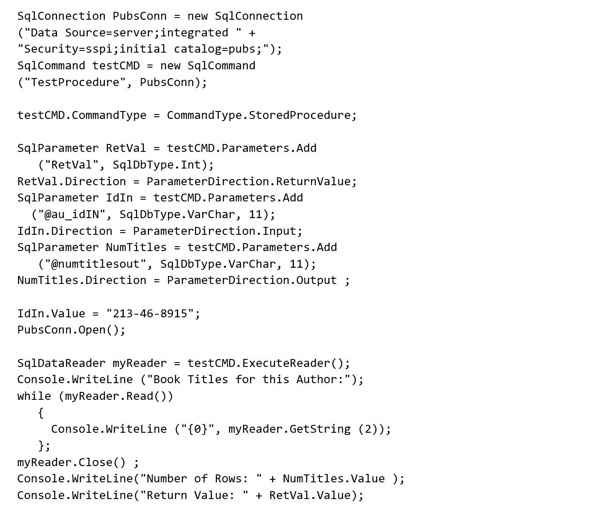
Calling Stored Procedure

Slide 33
Using Parameters
When you are using stored procedures on a SQL Server database or on another procedure-based database, parameters can be used to pass and retrieve information from the stored procedure.
Use parameter collection to pass parameters to Sp
When you use parameters with a SQL Server database, the names of the parameters that are added to the Parameters collection of the Command object must match the names of the parameters that are in the stored procedure;
Parameter Use
Input Used by your Web application to send specific data values to a stored procedure.
Output Used by a stored procedure to send specific values back to the calling Web application.
InputOutput Used by a stored procedure to both retrieve information that was sent by your Web application and to send specific values back to the Web application.
ReturnValue Used by a stored procedure to send a return value back to the calling application.

Slide 34
Transactions
A transaction is a set of related tasks that either succeed or fail as a unit
In transaction processing terminology, the transaction either commits or aborts. For a transaction to commit, all participants must guarantee that any change to data will be permanent. Changes must persist despite system crashes or other unforeseen events.
If even a single participant fails to make this guarantee, the entire transaction fails. All changes to data within the scope of the transaction are rolled back to a specific set point.
ACID Properties:
The term ACID conveys the role transactions play in mission-critical applications
Atomicity
Consistency
Isolation
Durability

Slide 35
ACID
Atomicity
A transaction is a unit of work in which a series of operations occur between the BEGIN TRANSACTION and END TRANSACTION statements of an application. A transaction executes exactly once and is atomic — all the work is done or none of it is.
Operations associated with a transaction usually share a common intent and are interdependent. By performing only a subset of these operations, the system could compromise the overall intent of the transaction. Atomicity eliminates the chance of processing a subset of operations.
Consistency
A transaction is a unit of integrity because it preserves the consistency of data, transforming one consistent state of data into another consistent state of data.
Consistency requires that data bound by a transaction be semantically preserved, in developing an application that transfers money, you should avoid arbitrarily moving decimal points during the transfer.
Isolation
A transaction is a unit of isolation — allowing concurrent transactions to behave as though each were the only transaction running in the system.
Isolation requires that each transaction appear to be the only transaction manipulating the data store, even though other transactions may be running at the same time. A transaction should never see the intermediate stages of another transaction.
Durability
A transaction is also a unit of recovery. If a transaction succeeds, the system guarantees that its updates will persist, even if the computer crashes immediately after the commit. Specialized logging allows the system's restart procedure to complete unfinished operations, making the transaction durable

Slide 36
Types Of Transactions
Manual transactions.
You write code that uses the transaction support features of either ADO.NET or Transact-SQL directly in your component code or stored procedures, respectively.
Automatic (COM+) transactions.
You add declarative attributes to your .NET classes that specify the transactional requirements of your objects at run time. This model allows you to easily configure multiple components to perform work within the same transaction
Choosing a Transaction Model
Prior to choosing a transaction model, you should consider whether or not you require transactions at all. Transactions are the single most expensive resource consumed by server applications, and they reduce scalability when used unnecessarily. Consider the following guidelines governing the use of transactions:
Perform transactions only when you need to acquire locks across a set of operations and need to enforce ACID rules.
Keep transactions as short as possible to minimize the amount of time that you hold database locks.
Never place a client in control of transaction lifetime.
Don't use a transaction for an individual SQL statement. SQL Server automatically runs each statement as an individual transaction

Slide 37
Automatic Vs Manual
Manual local transactions are always significantly faster because they do not require interaction with the Microsoft DTC. This is true (although the performance degradation is reduced) even if you are using automatic transactions against a single local resource manager (such as SQL Server), because a manual, local transaction avoids any unnecessary inter process communication (IPC) with the DTC.
Use manual transactions when:
You are performing a transaction against a single database.
Use automatic transactions when:
You require a single transaction to span multiple remote databases.
You require a single transaction to encompass multiple resource managers—for example, a database and a Windows 2000 Message Queuing (formerly known as MSMQ) resource manager.
Note Avoid mixing your transaction models. Use one or the other

Slide 38
ADO.NET Transactions
A transaction in ADO.NET is begun by calling one of the BeginTransaction() methods on the database connection objec
SqlConnection conn = new SqlConnection(source); conn.Open();
SqlTransaction tx = conn.BeginTransaction(); // Execute some commands, then commit the transaction tx.Commit(); conn.Close();
Try to role back in catch block

Slide 39
Isolation Levels
Read uncommitted
When it's used, SQL Server not issue shared locks while reading data. So, you can read an uncommitted transaction that might get rolled back later. This isolation level is also called dirty read. This is the lowest isolation level. It ensures only that a physically corrupt data will not be read.
Read committed
This is the default isolation level in SQL Server. When it's used, SQL Server will use shared locks while reading data. It ensures that a physically corrupt data will not be read and will never read data that another application has changed and not yet committed, but it does not ensure that the data will not be changed before the end of the transaction.
Repeatable read
When it's used, the dirty reads and non repeatable reads cannot occur. It means that locks will be placed on all data that is used in a query, and another transactions cannot update the data.
Serializable
Most restrictive isolation level. When it's used, then phantom values cannot occur. It prevents other users from updating or inserting rows into the data set until the transaction is complete.

Slide 40
Connectionless
Motivation
Many parallel, long lasting access operations
Connection-oriented data access too costly
Idea
Caching data in main memory
➔ “main memory data base“
Only short connections for reading and updates
➔ DataAdapter
Main memory data base independent from data source
conflicting changes are possible

Slide 41
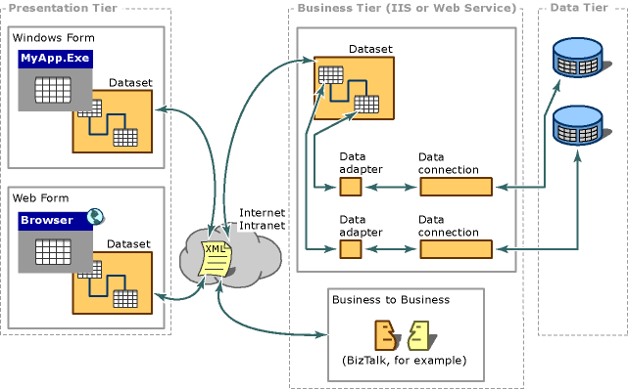
Microsoft 3 Tier Arch

Slide 42
ADO Technology Chain
DataAdapter
Conn ection
Data
store
XML
DataAdapter
Conn ection
Data
store
DataGrid
DataView
DataSet
DataSet

Slide 43
Dataset
DataSet objects are complex objects that allow you to store multiple
DataTables of data from a data source. DataSet objects are similar to a virtual database that is inside a Web Application. DataSet
DataSet consists of collection of DataTables collection of DataRelations
DataTables consists of collection of DataTableColumns (= schema definition)
collection of DataTableRows (= data)
DefaultView (DataTableView, see later)
DataRelations associate two DataTable objects define ParentTable and ParentColumns and ChildTable and ChildColumns
Dataset works in disconnected manner
The DataSet object can use a DataAdapter object to load data from a data source and can then disconnect from that data source
The user can then use and manipulate the data. When the data needs to be updated in the data source, a DataAdapter is used to reconnect and update the data source.

Slide 44
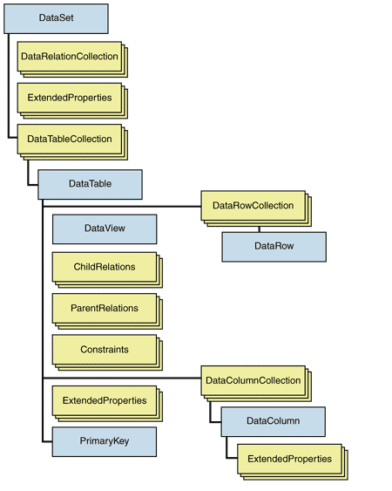
Dataset

Slide 45
Creating Data Adapter
A Data Adapter object serves as a link between a DataSet object and a data source that can be used for retrieving and saving data
Store the query in a DataAdapter
SqlDataAdapter da = new SqlDataAdapter("select * from Authors",conn);
The DataAdapter constructor sets the SelectCommand property
da.SelectCommand.CommandText;
da.SelectCommand.Connection;
IIDataAdapter
SQLDataAdapter
OLEDBAdapter
ODBCAdapter

Slide 46
Architecture
DataAdapter for connection to data source
Fill: Filling the DataSet
Update: Writing back changes
DataAdapters use Command objects
SelectCommand
InsertCommand
DeleteCommand
UpdateCommand
connectionless
connection-oriented

Slide 47
Properties Of Adapter
When you use DataAdapter objects to exchange data between a DataSet object and a data source, you can specify the actions that you want to perform by using one of the four DataAdapter properties.
Property | Function
SelectCommand | The Select Command property retrieves rows from the data source.
InsertCommand | The Insert Command property writes inserted rows from the DataSet into the data source.
UpdateCommand | The Update Command property writes modified rows from the DataSet into the data source.
DeleteCommand | The Delete Command property delete rows in the data source.

Slide 48
Creating Dataset

Slide 49
Loading Data
Create DataAdapter object and set SelectCommand
IDbDataAdapter adapter = new OleDbDataAdapter();
OleDbCommand cmd = new OleDbCommand();
cmd.Connection = new OleDbConnection ("provider=SQLOLEDB; ..." );
cmd.CommandText = "SELECT * FROM Person";
adapter.SelectCommand = cmd
Read data from data source and fill DataTable "Person”
adapter.Fill(ds, "Person");
AcceptChanges & RejectChanges

Slide 50
Writing back Changes
Create update commands using CommandBuilder
OleDbCommandBuilder cmdBuilder = new OleDbCommandBuilder(adapter);
Call Update() to Handle the conflicts
Update-, Insert- and DeleteCommand define how changes are written
CommandBuilder can create Update-, Insert- und DeleteCommand from SelectCommand automatically (in simple cases )
Conflict management for updates:
comparison of data in DataTable and data source
in case of conflict DBConcurrencyException is thrown

Slide 51
Storing Multiple Tables

Slide 52
Creating Relations

Slide 53
Navigating Between tables

Slide 54
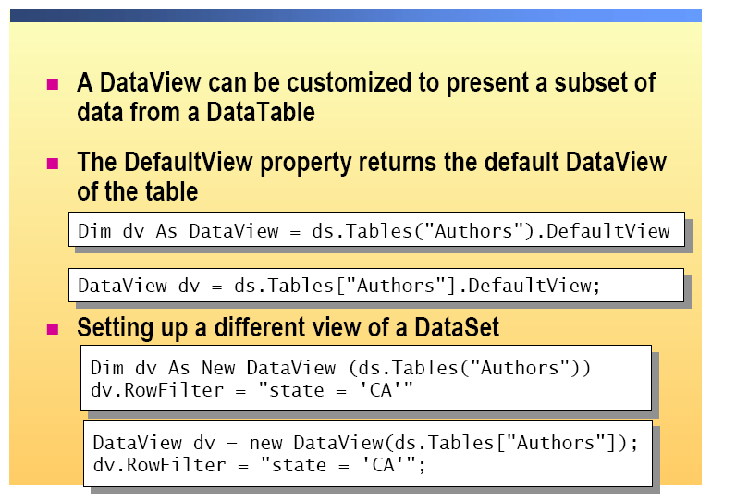
Data View
To display the data that is held in a DataSet object, you can bind the DataSet object directly to a list-bound control or use a DataView object.

Slide 55
Data Reader vs. Dataset

Slide 56
List bound Controls
We can directly link data-bound controls that are on a Web Form to a data source.
List-bound controls are controls that connect to a data source and then display the data from that source. The list-bound controls are directly linked to a data source. ASP.NET automatically fills the list-bound control with data.
Control | Description
CheckBoxList | A multi-selection check box group that can be dynamically generated by using data binding.
DataGrid | A control that displays the fields of a data source as columns in a table.
DataList | A control that displays a template-defined data bound list.
DropDownList | A single selection, drop-down list control.
ListBox | A list control that allows single or multiple item selection.
RadioButtonList | A single-selection radio button group that can be dynamically generated through data binding.
Repeater | A data-bound list that uses a template. This control has no built-in layout or styles, so you must explicitly declare all HTML layout, formatting, and style tags with in control’s templates

Slide 57
Displaying Dataset Dataset

Slide 58
Customizing the Data Grid
AutoFormat
Setting Custom Column Headers
Paging
Sorting

Slide 59
Thank You

